Slide 1


Default of Credit Card Clients
Subject: Data Analytics
Presented By,
Hetarth Bhatt – 251056818
Khushali Patel – 25105445
Rajaraman Ganesan – 251056279
Vatsal Shah – 251041322
Department of Electrical & Computer Engineering (M.Engg)
Western University, Canada

Slide 2
AGENDA
Credit Card Default Problem (DEMO)
Problem Overview
Dataset Overview
Data Preparation
Proposed Models
Evaluation
Conclusion

Slide 3
Overview
Banking / Financial Institutes plays a significant role in providing financial service.
To maintain the integrity, bank/institute must be careful when investing in customers to avoid financial loss.
Before giving credit to borrowers, the bank must come to about the potential of customers.
The term credit scoring, determines the relation between defaulters and loan characteristics.

Slide 4
Goal
The model we built here will use all possible factors to predict data on customers to find who are defaulters and non-defaulters next month.
The goal is to find the whether the clients are able to pay their next month credit amount.
Identify some potential customers for the bank who can settle their credit balance.
To determine if their customers could make the credit card payments on-time.
Default is the failure to pay interest or principal on a loan or credit card payment.

Slide 5
Process Design
The process is done by Supervised learning Algorithm.
The idea behind using this is we have a prior knowledge on our output values.
It acts as a guide to teach the algorithms what conclusion it should come up with.
Common algorithms in supervised learning includes logistic regression, naive bayes, support vector machines and decision tree classifier.

Slide 6
Approach Design
Preparation
of data
Applying models
Analyse the Best model
Comparing the applied models
Evaluation Model

Slide 7
Credit Card Default Problem (DEMO)
Problem Overview
Dataset Overview
Data Preparation
Proposed Models
Evaluation
Conclusion

Slide 8
Dataset Overview
Oriented: UCI Machine Learning Repository. (Link)
Attributes: 24
Tuples: 30,000
Non-default
Default
Customers data
Non-default
Customers data
Non-default
Non-default

Slide 9
Continue…
Independent variables:
Customer ID
Credit limit
Gender
Age
Marital status
Level of education
History of their past payments made (April to September) (g1 to g6)
Amount of bill statement (h1 to h6)
Amount of previous payment (i1 to i6)
Dependent variables:
default – A customer who will be default next month payment (0: no, 1: yes)

Slide 10
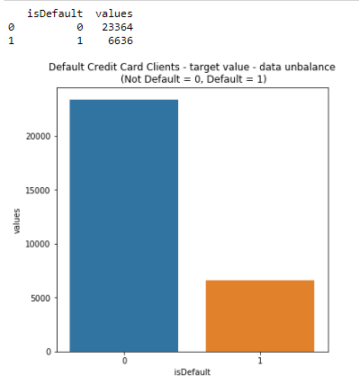
Dataset overview
Graph shows total number of records for defaulters and non-defaulters.
If they would do payment or not (yes=1 no=0) for next month
22% - default
78% - non-default
(Screenshot: Taken during evaluation process)

Slide 11
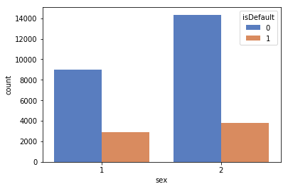
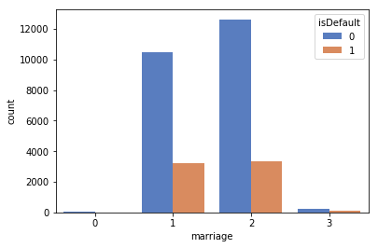
Continue…
1. It shows count for ‘sex’ attribute
1 - Male and 2 - Female
2. It shows default count for ‘marriage’ attribute
0,3 - Others, 1 - Married, 2 - Single
(Screenshot 1,2: Taken during evaluation process)

Slide 12
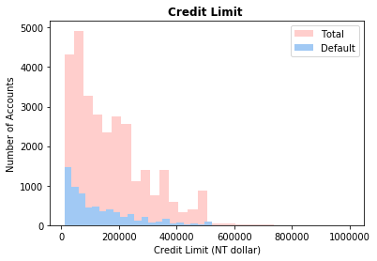
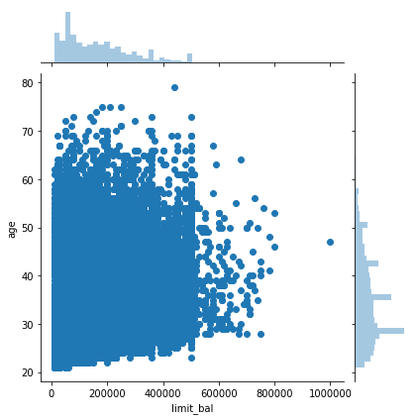
Continue…
1. It shows count for Total ‘Credit limit’ attribute values with respect to Number of Account
2. It shows Limit of balance with respect to age.
(Screenshot 1,2: Taken during evaluation process)

Slide 13
Credit Card Default Problem (DEMO)
Problem Overview
Dataset Overview
Data Preparation
Proposed Models
Evaluation
Conclusion

Slide 14
Data Preprocessing
Data set is divided in 60:40 ratio for train and test respectively.
ID column was dropped as its unnecessary for our modeling.
The attribute name ‘PAY_0’ was converted to ‘PAY_1’ for naming convenience.
Pay_0: No consumption of credit card=-2, Pay duly(paid on time)=-1, payment delay for one month=1, payment delay for two months=2, payment delay for nine months and above=9.
Marital Status 0 is converted to value 3 (Others).
No Null values in dataset.
Robust Scaler – It is used to convert variable in the same scale. Ex. in Limit Balance column there are different range of values which are converted in proper scale.

Slide 15
Feature Engineering
Education
Gender
Marital status
Education | Value
Graduate | 1
University | 2
High School | 3
Others | 4
Gender | Value
Male | 1
Female | 2
Marital Status | Value
- | 0
Married | 1
Single | 2
Others | 3

Slide 16
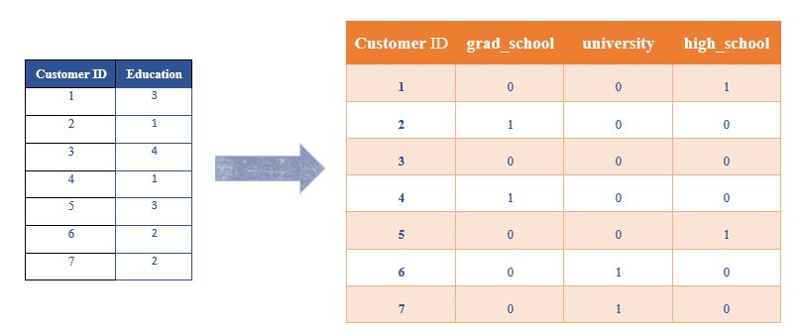
One-Hot Encoding
The process in which Categorical variables are converted into a form, where we can apply algorithms to do prediction easily.
(n-1) features
Ex. There are 4 features in Education → Converted to 3 features (n-1)

Slide 17
Credit Card Default Problem (DEMO)
Problem Overview
Dataset Overview
Data Preparation
Proposed Models
Evaluation
Conclusion

Slide 18
Proposed Models
Logistic Regression
It is used for Binary classification.
Outputs have a nice probabilistic interpretation, and the algorithm can be regularized to avoid over fitting.
In logistic regression the hypothesis is that the conditional probability p of class belongs to ”1”
if probability is greater than threshold probability, generally 0.5, else it belongs to the class ”0”.
Ex. Y$\left(i\right)=\left\{\begin{aligned}1 , p≥0.5 \\ &0, p<0.5\end{aligned}\right.$
Ex. Y(𝑖)={█(1 , 𝑝≥0.5@&0, 𝑝<0.5)┤
Support Vector Machine
Kernel: linear and enabled probability: ‘true’
Soft-SVM search used in the process.
Hard-SVM searches for the decision boundary that separates the training data separately with the largest margin.
Soft-SVM is based on the assumption that learning data is not perfectly separable.

Slide 19
Continue…
Feed Forward Neural Network
Activation function : Rectified Linear Unit(ReLU) and Sigmoid
SGD: adam
Epochs: 100
Loss function: Binary cross entropy
Input layer : 26, Hidden layer : 2, Output: 1
Early Stopping
Feed forward NN is used with Backpropagation algorithm. Below parameters decided tuned parameters
Voting Classifier
Estimators: list of classifiers
Combined average of Logistic Regression + Decision tree Classifier + Support Vector Machine (SVM)
Naïve Bayes, KNN and Decision Tree classifier

Slide 20
Evaluation Process
Evaluation Metrics:
Accuracy: Accuracy determine how often the model predicts default and non-default correctly.
Precision: Precision calculates whenever our models predicts it is default how often it is correct.
Recall: Recall regulate the actual default that the model is actually predict.
Precision Recall Curve: PRC will display the tradeoff between precision and recall threshold.
Cross Validation:
K Fold cross validation; k = 5

Slide 21
Confusion Metrics
True Positive – A person who is defaulter and predicted as defaulter.
True Negative – A person who is non-defaulter and predicted as non-defaulter.
False Positive – A person who is predicted defaulter is non-defaulter.
False Negative – A person who is predicted non-defaulter is defaulter.
# | Non-defaulter (predicted) - 0 | Defaulter (predicted) - 1
Non-defaulter (actual) - 0 | TN | FP
Defaulter (actual) - 1 | FN | TP

Slide 22
Credit Card Default Problem (DEMO)
Problem Overview
Dataset Overview
Data Preparation
Proposed Models
Evaluation
Conclusion

Slide 23
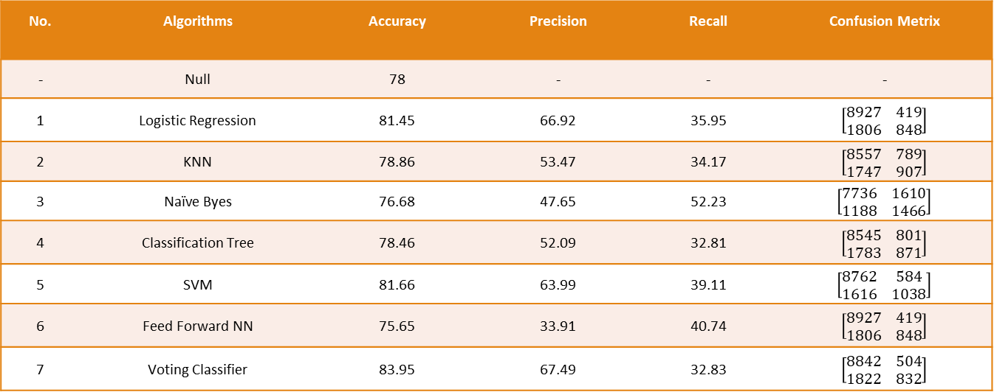
Evaluation Result
No. | Algorithms | Accuracy | Precision | Recall | Confusion Metrix
- | Null | 78 | - | - | -
1 | Logistic Regression | 81.45 | 66.92 | 35.95 | $$\left[\begin{matrix}8927 & 419 \\ 1806 & 848\end{matrix}\right]$$
2 | KNN | 78.86 | 53.47 | 34.17 | $$\left[\begin{matrix}8557 & 789 \\ 1747 & 907\end{matrix}\right]$$
3 | Naïve Byes | 76.68 | 47.65 | 52.23 | $$\left[\begin{matrix}7736 & 1610 \\ 1188 & 1466\end{matrix}\right]$$
4 | Classification Tree | 78.46 | 52.09 | 32.81 | $$\left[\begin{matrix}8545 & 801 \\ 1783 & 871\end{matrix}\right]$$
5 | SVM | 81.66 | 63.99 | 39.11 | $$\left[\begin{matrix}8762 & 584 \\ 1616 & 1038\end{matrix}\right]$$
6 | Feed Forward NN | 75.65 | 33.91 | 40.74 | $$\left[\begin{matrix}8927 & 419 \\ 1806 & 848\end{matrix}\right]$$
7 | Voting Classifier | 83.95 | 67.49 | 32.83 | $$\left[\begin{matrix}8842 & 504 \\ 1822 & 832\end{matrix}\right]$$

Slide 24
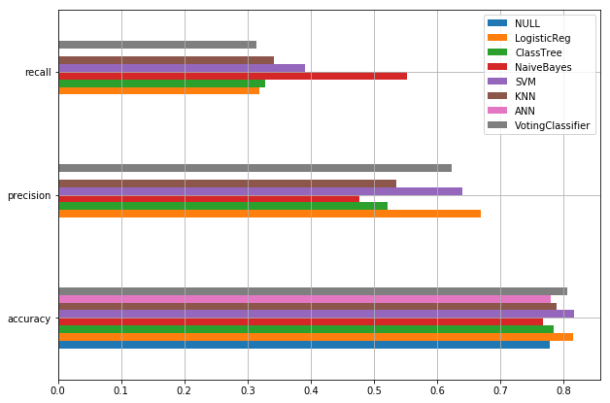
Graphical representation
Bar chart representation of Precision, Recall and Accuracy values

Slide 25
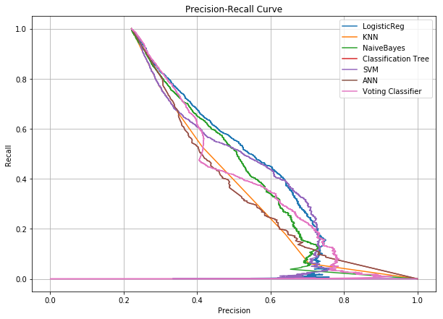
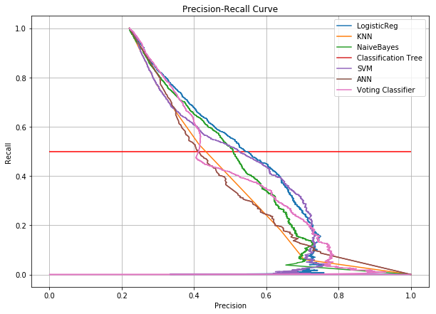
Precision-Recall curve
Comparison of implemented algorithms with Precision-recall curve

Slide 26
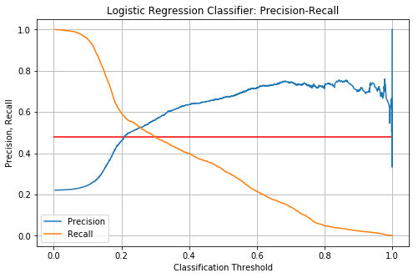
Precision Recall curve with threshold
Precision-Recall comparison with respect to the threshold value.
Adjust precision and recall value by adjusting threshold value
We set threshold value → 0.2
False Negative value is improved by 40%.

Slide 27
Credit Card Default Problem (DEMO)
Problem Overview
Dataset Overview
Data Preparation
Proposed Models
Evaluation Process
Conclusion

Slide 28
Conclusion
We investigated the data, checking for data unbalancing, visualizing the features and understanding the relationship between different features.
We used both train-validation split and cross-validation to evaluate the model effectiveness to predict the target value, i.e. detecting if a credit card client will default next month.
We then investigated five predictive models:
We started with Logistic Regression, Naïve bayes, SVM, KNN, Classification Tree and Feed-forward NN and Voting classifier accuracy is almost same.
We choose based model based on minimum value of False Negative value.
This would also inform the issuer’s decisions on who to give a credit card to and what credit limit to provide.

Slide 29
Credit Card Default Problem (DEMO)
Problem Overview
Dataset Overview
Data Preparation
Proposed Models
Evaluation Process
Conclusion

Slide 30
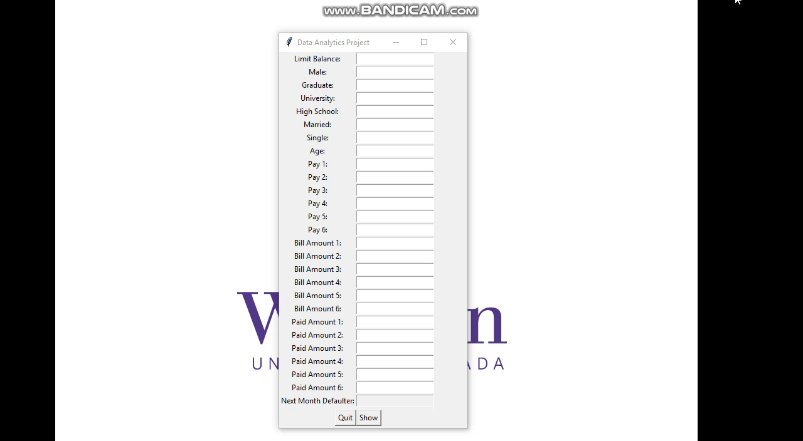
Demo

Slide 31

QR Code
Scan QR code and access PPT AND CODE (Access the code: http://vatsalshah.in/projects.html )

Slide 32
References
Li, Xiao-Lin, and Yu Zhong. An overview of personal credit scoring: techniques and future work. Journal: International Journal of Intelligence Science ISSN 2163-0283. 2012.
Federal Reserve. (2017) “Report to the Congress on the Profitability of Credit Card Operations of Depository Institutions”.
Taiwo Oladipupo Ayodele. (2010) “Types of Machine Learning Algorithms”, New Advances In Machine Learning, Yagang Zhang (Ed.), Intech
Default Credit Card Clients Dataset, https://www.kaggle.com/uciml/default-of-credit-card-clients-dataset/
Davis J., Goadrich M. The Relationship Between Precision-Recall and ROC Curves. ACM New York, NY, USA 2006. ISBN:1-59593-383-2.
Arlot, Sylvain, and Alain Celisse. A survey of cross-validation procedures for model selection. eprint arXiv:0907.4728. DOI:10.1214/09-SS054.
https://www.analyticsvidhya.com/blog/2016/03/introduction-deep-learning-fundamentals-neural-networks/

Slide 33


Slide 34
Contact Us
You can share your feedback on below Email-IDs.
Hetarth Bhatt – hbhatt7@uwo.ca
Khushali Patel – kpate372@uwo.ca
Rajaraman Ganesan – rganesa@uwo.ca
Vatsal Shah – vshh56@uwo.ca (http://vatsalshah.in)

Slide 35
THANK YOU

